Slide 1
Teaching the Sustainable Development Goals Through Cooperative Learning
Steven Lim
Meikai University
stevenmenjinlim@gmail.com

Slide 2
Cooperative Learning and the Sustainable Development Goals
Lim, S.
Reidak, J.
Chau, M. H.
Zhu, C.
Guo, Q.
Brooks, T. A.
Roe, J.
Jacobs, G. M.
https://payhip.com/b/obOwr

Slide 3
Presentation Outline
1. What are the Sustainable Development Goals (SDGs)?
2. What is Cooperative Learning (CL)?
3. SDGs lesson activities using CL
4. The book

Slide 4
1. What are the Sustainable Development Goals (SDGs)?

Slide 5
What are the Sustainable Development Goals (SDGs)?
17 global goals established by the United Nations in 2015 as part of the 2030 Agenda for Sustainable Development
Address social issues, climate change, and promote sustainable development
How many do you know?

Slide 7
1. No Poverty
2. Zero Hunger
3. Good Health and Well-being
4. Quality Education
5. Gender Equality
6. Clean Water and Sanitation
7. Affordable and Clean Energy
8. Decent Work and Economic Growth
9. Industry, Innovation, and Infrastructure
10. Reduced Inequality
11. Sustainable Cities and Communities
12. Responsible Consumption and Production
13. Climate Action
14. Life Below Water
15. Life on Land
16. Peace, Justice, and Strong Institutions
17. Partnerships for the Goals

Slide 9
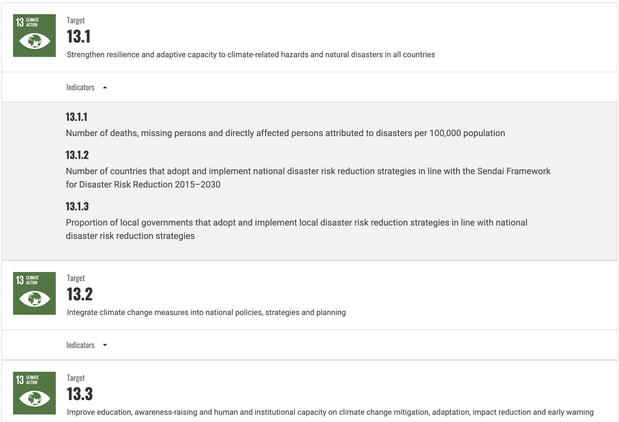
General concepts with specific goals

Slide 10
Introducing the SDGs
Matching
Caption
Logo design
Group presentations

Slide 11
SDGs in Japan
Consumers in Japan
Recognition rate of ‘SDGs’ is 87% (36 points more than 2020)
3 in 4 of all consumers answered that they were considering contributing to the SDGs when purchasing products.
https://insight.rakuten.com/sdgs-consumer-awareness-in-japan/
Gen Z in Japan (15-24)
Gen Z are highly motivated to commit to the SDGs
Gen Z is very concerned about gender inequality
The majority of Gen Z learned about the SDGs at school or at work
https://www.dentsu.co.jp/en/news/release/2022/0427-010519.html

Slide 12
In media
TV segments focused on the SDGs in the greater Tokyo and Osaka urban-areas:
493 in 2020
2,836 in 2021
https://www.dentsu.co.jp/en/news/release/2022/0427-010519.html
Have you seen the logos? If so, where?

Slide 13
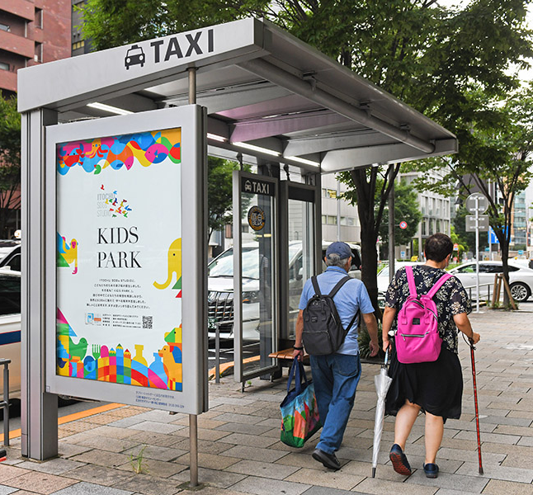
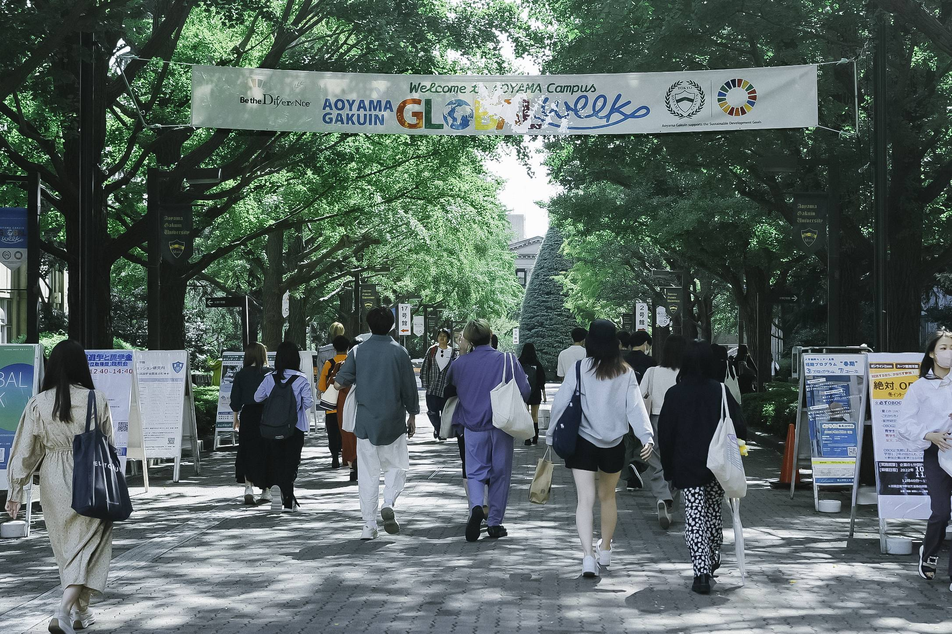
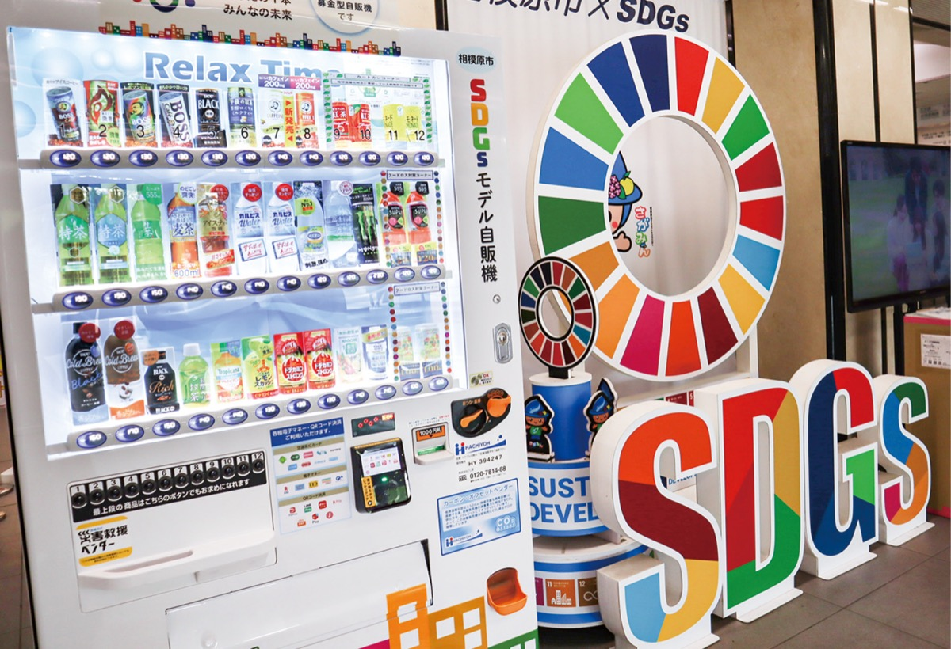

Slide 18
But despite high awareness…
The Sustainable Development Solutions Network gave Japan the worst score for five goals:
Gender Equality (Goal 5)
Responsible Consumption and Production (Goal 12)
Climate Action (Goal 13)
Life Below Water (Goal 14)
Life on Land (Goal 15)
https://www.asahi.com/ajw/articles/14938994

Slide 19
Why teach the SDGs?
20 companies responsible for 55% of single-use plastic waste https://www.cnbc.com/2021/05/18/20-companies-responsible-for-55percent-of-single-use-plastic-waste-study.html
100 companies are responsible for 71% of GHG emissions
https://www.activesustainability.com/climate-change/100-companies-responsible-71-ghg-emissions/?_adin=02021864894

Slide 20
Why teach the SDGs?
Every little helps
Consumer pressure
Future influencers
A good fit for modern teaching styles

Slide 21
The SDGs and Critical Thinking Skills
Research
Multiple sources designed with children and L2 learners in mind
Analysis
Solid data to examine
(Scalable) problem-solving
Can identify local issues and solutions
Linking ideas
Textbook chapters lend themselves to SDG connectivity

Slide 22
Most importantly…
Actionable!

Slide 23
2. What is Cooperative Learning (CL)?

Slide 24
What is Cooperative Learning (CL)?
“Cooperative learning (CL) is a teaching method that consists of principals and techniques for helping students work together to learn and achieve other goals”
CL emphasizes the importance of working in a group
How do you choose groups? Why do you use that method?
Preassigned groups (e.g., lunch groups)
Balance (e.g., proficiency, gender)
‘Good fit’ (e.g., proficiency, gender)
Random (e.g., random numbers)
Other

Slide 25
8 Principles of CL
1. Positive Interdependence
Helping one group member helps all group members
2. Individual Accountability
Everyone in the group feels a need to do their fair share
3. Equal Opportunity to Participate
Everyone has a chance to take part
4. Maximum Peer Interactions
Students’ peers are the other students

Slide 26
8 Principles of CL
5. Group Autonomy
Groups first try to learn from and with their group members
6. Heterogeneous Grouping
Groups usually have diverse membership
7. Teaching Cooperative Skills
Students need to learn these skills as well as practice using them
8. Cooperation as a Value
The feeling of positive interdependence expands beyond the group

Slide 27
The Free Rice Game
https://play.freerice.com
How could you make this a pair game?
Example: Tell/Check Record
One student is the Teller the other is the Checker and Recorder
The Teller guesses the answer, the Checker gives their opinion. They can discuss. The Teller makes a decision
If they get an answer wrong, the Recorder writes it down for future study
Students take turns to do the roles

Slide 28
What Principles does Tell/Check Record Use?
1. Positive Interdependence
Helping one group member helps all group members
2. Individual Accountability
Everyone in the group feels a need to do their fair share
3. Equal Opportunity to Participate
Everyone has a chance to take part
4. Maximum Peer Interactions
Students’ peers are the other students
5. Group Autonomy
Groups first try to learn from and with their group members
6. Heterogeneous Grouping
Groups usually have diverse membership
7. Teaching Cooperative Skills
Students need to learn these skills as well as practice using them
8. Cooperation as a Value
The feeling of positive interdependence expands beyond the group

Slide 29
CL Techniques
7S
Cooperative Debate
Cooperative Dialog Journals
Dictogloss
Everyone Can Explain
Exchange-a-Question
Forward Snowball
Gallery Tour
Group Investigation
Group Projects
Jigsaw
K-W-L-S
Skits
SUMMER
The Circle Family of Techniques
The Tell Family of Techniques
Think Aloud Squares
Think-Pair-Share

Slide 30
CL Techniques
7S
Cooperative Debate
Cooperative Dialog Journals
Dictogloss
Everyone Can Explain
Exchange-a-Question
Forward Snowball
Gallery Tour
Group Investigation
Group Projects
Jigsaw
K-W-L-S
Skits
SUMMER
The Circle Family of Techniques
The Tell Family of Techniques
Think Aloud Squares
Think-Pair-Share

Slide 31
Group project common issues
One or two people dominate
Some students don’t contribute
How do you try to prevent these issues?

Slide 32
Group projects - Positive interdependence Helping one group member helps all group members
Everyone has a unique role (eg., questioner, language captain, notetaker, manager, reporter, decider)
Everyone gathers data from different sources or media
The group has a self-created indentity

Slide 33
Group projects - Individual accountability Everyone in the group feels a need to do their fair share
Each member has a speaking part in any project presentation
Each member writes reflection pieces about the project experience
Groupmates evaluate each other’s contribution to the group
The group has a roster indicating what each member has agreed to do
A facilitator encourages everyone to participate and assists those who require help

Slide 34
3. SDGs lesson activities using CL

Slide 35
Example 1: Finding a ‘Why’ for a ‘What’
Exchange-a-Question
Students find a fact (e.g., about the different situations between men and women in their country) and make a multiple-choice question
The Questioner asks their partner
The Answerer chooses a response and explains their guess
The Questioner gives the answer. The pair discuss why this may be the case
The pair switch roles
The pair switch questions and make new pairs

Slide 36
What percentage of IT engineers are women?
5
20
40
60

Slide 37
What percentage of IT engineers are women?
5
20
40
60
https://asia.nikkei.com/Spotlight/Datawatch/Japan-s-digital-future-depends-on-women

Slide 38
Review
Post all questions and answers on the wall. Students try to explain one and add information
Students could discuss which answers they thought were the most surprising and why they were surprised
The whole class could work on only one question, but each student would do research about a different country (e.g., “What percentage of elementary school teachers are women in Brazil?”)

Slide 39
Example 2: Our class in data
Goals:
Students learn how to interpret bar charts
Students consider how to improve research
Students practice gathering data
Students experience presenting data
Students use data to make actionable suggestions

Slide 40
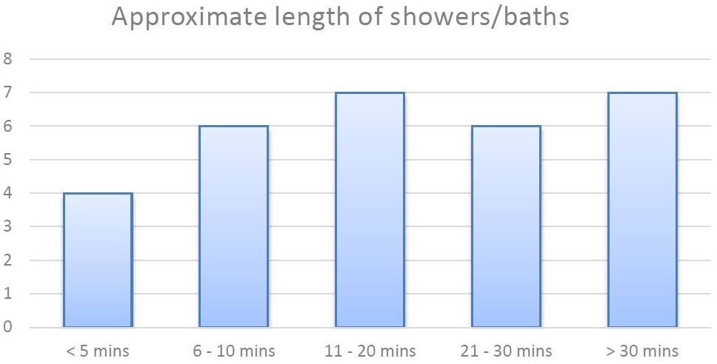
Analysis steps
Examine the bar chart and identify the topic
Choose labels for the X and Y axis
Make statements using the data (e.g., 4 people take showers or baths for less than 5 minutes)
Make interpretations based on the data (e.g., the 8 people who take showers or baths for more than 30 minutes must have small families)
Consider how to improve the research (e.g., separate bath and shower columns)
Connect the data to the SDGs (e.g., SDG 12 – responsible consumption and production)
Consider how to encourage people to save water

Slide 41
Action steps
In pairs decide on an SDG related question
Interview classmates
Make a bar chart using the data
Present the data to the rest of the class including SDGs-related suggestions based on the data

Slide 42
Key points
CL elements:
Positive interdependence
Maximum peer interactions
Critical thinking elements:
Data is analyzed and presented
Wider implications are considered and suggestions made

Slide 43
4. The book

Slide 44
Three (free) books we learned from
Integrating global issues in the creative English language classroom: With reference to the United Nations Sustainable Development Goals (Edited by Alan Maley and Nik Peachey)
Creating Change: Global Issues in ELT in Africa (edited by Linda Ruas)
Creating Global Change (edited by Linda Ruas)

Slide 46
Contents
1. COOPERATIVE LEARNING
2. COOPERATIVE LEARNING TECHNIQUES
3. COOPERATIVE LEARNING TEACHING TIPS
4. THE SUSTAINABLE DEVELOPMENT GOALS
5. THE 17 SUSTAINABLE DEVELOPMENT GOALS
6. HOW CL AND THE SDGS FIT TOGETHER
7. SDGS ACTIVITIES WITH CL TECHNIQUES

Slide 47
Contents
1. COOPERATIVE LEARNING
2. COOPERATIVE LEARNING TECHNIQUES
3. COOPERATIVE LEARNING TEACHING TIPS
4. THE SUSTAINABLE DEVELOPMENT GOALS
5. THE 17 SUSTAINABLE DEVELOPMENT GOALS
6. HOW CL AND THE SDGS FIT TOGETHER
7. SDGS ACTIVITIES WITH CL TECHNIQUES

Slide 49
Contents
1. COOPERATIVE LEARNING
2. COOPERATIVE LEARNING TECHNIQUES
3. COOPERATIVE LEARNING TEACHING TIPS
4. THE SUSTAINABLE DEVELOPMENT GOALS
5. THE 17 SUSTAINABLE DEVELOPMENT GOALS
6. HOW CL AND THE SDGS FIT TOGETHER
7. SDGS ACTIVITIES WITH CL TECHNIQUES

Slide 51
Contents
1. COOPERATIVE LEARNING
2. COOPERATIVE LEARNING TECHNIQUES
3. COOPERATIVE LEARNING TEACHING TIPS
4. THE SUSTAINABLE DEVELOPMENT GOALS
5. THE 17 SUSTAINABLE DEVELOPMENT GOALS
6. HOW CL AND THE SDGS FIT TOGETHER
7. SDGS ACTIVITIES WITH CL TECHNIQUES

Slide 52
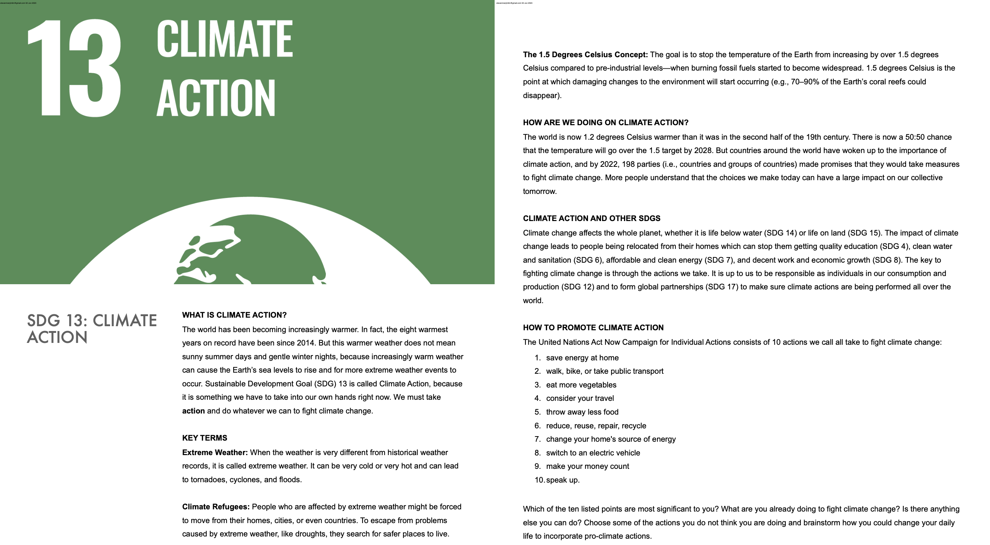

Slide 53
Contents
1. COOPERATIVE LEARNING
2. COOPERATIVE LEARNING TECHNIQUES
3. COOPERATIVE LEARNING TEACHING TIPS
4. THE SUSTAINABLE DEVELOPMENT GOALS
5. THE 17 SUSTAINABLE DEVELOPMENT GOALS
6. HOW CL AND THE SDGS FIT TOGETHER
7. SDGS ACTIVITIES WITH CL TECHNIQUES

Slide 55
The key points
Adapt existing activities using CL techniques
Adapt to ages, proficiency, interests
Tweak
Repeat
Tweak
Repeat
You know your students better than anyone!

Slide 56
Thank you for listening
Steven Lim
stevenmenjinlim@gmail.com

